Slide 1
Integrated Marketing Communication: Foundations

Slide 2
Overview
Integrated Marketing Communication (IMC) defined
Importance of IMC
Evolution of IMC
Promotional Mix
  Traditional
  Non-Traditional
Roles of Promotional Elements

Slide 3
IMC Defined
Integrated marketing communication (IMC) involves coordinating the various promotional elements and other marketing activities that communicate with the firm’s customers.
  Focuses on all sources of brand/company contact (“big picture” approach)

Slide 4
Importance of IMC
Increasing number of technologies means more communications media
Avoid duplication of marketing communication efforts
Avoid conflicting messages across marketing communications media

Slide 5
Traditional Promotional Mix
The traditional promotional mix comprised five basic tools used to accomplish a firm’s communications objectives:
Advertising
Direct Marketing
Sales Promotion
Public Relations
Personal selling

Slide 6
Pre-1990s IMC
Mass media dominated the promotional function
Firms relied heavily on ad agencies for guidance in all areas of marketing communication
Key metrics were reach, frequency, and CPM (cost per thousand impressions)
Sales promotion, direct marketing and PR viewed as more supportive rather than primary in marketing communications

Slide 7
Evolution of IMC
Media and audience fragmentation
Emergence of Internet advertising
Non-Traditional Marketing
Audience “engagement” a key objective

Slide 8
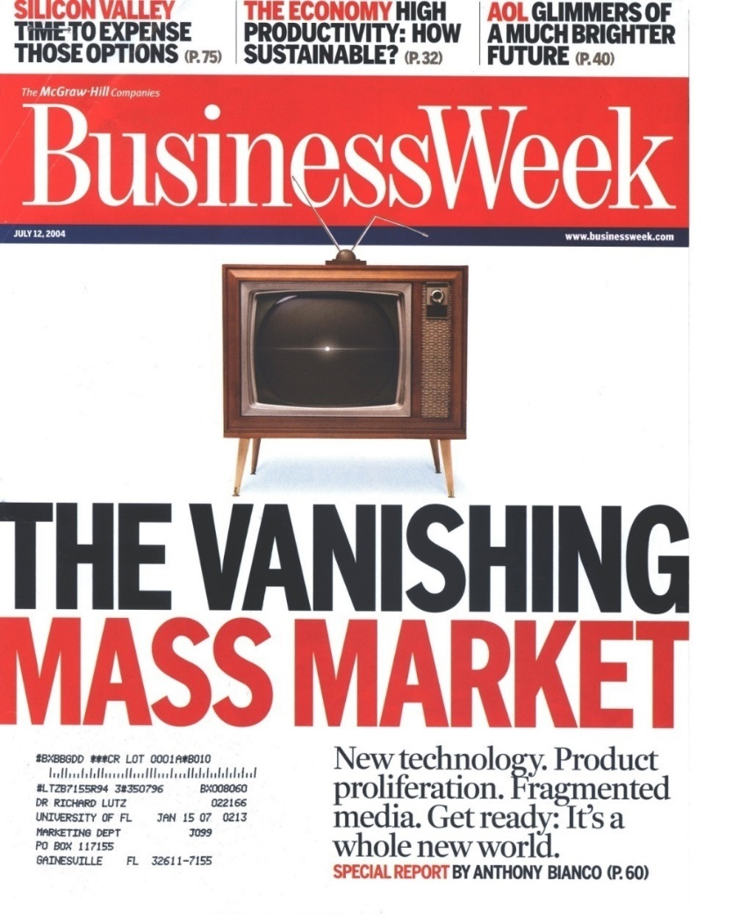
Media Fragmentation

Slide 9
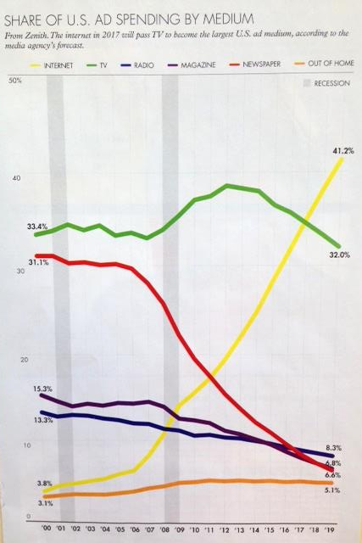
Media Trends

Slide 10
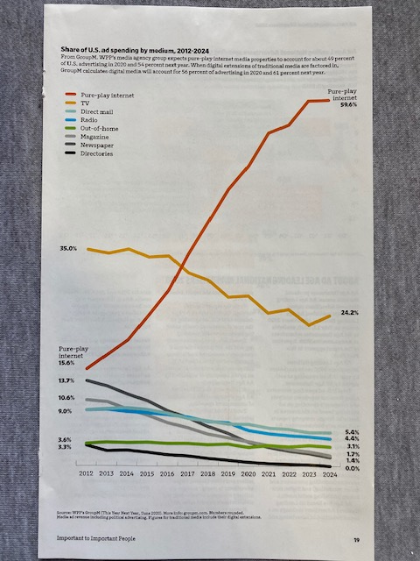
More Trends

Slide 11
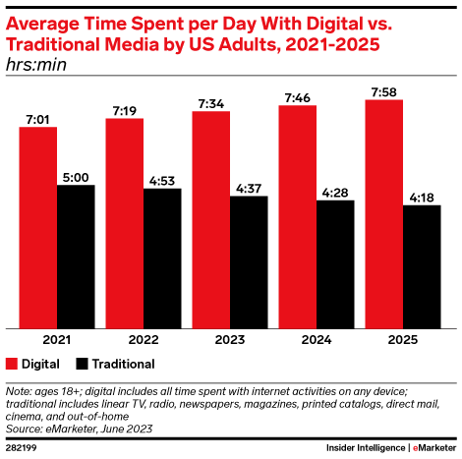
Time Spent on Media Daily

Slide 12
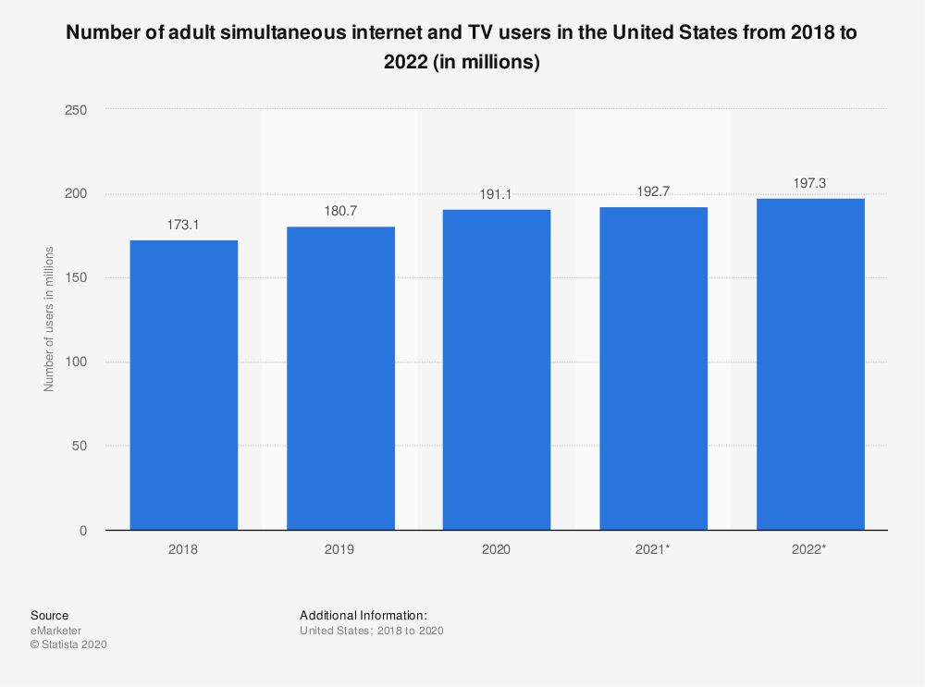
Simultaneous TV and Internet

Slide 13
Promotional Mix Elements Have…
Different tasks
Consistency
Complementarity
Synergy

Slide 14

Super Bowl Synergy
73 million TV ad impressions
169 million social media impressions

Slide 15
Conclusion
What is the “mix” of IMC elements that is used by your brand/organization?
Is it effectively integrated?
Does your promotional mix capitalize on synergies?

Slide 16
End of Lecture

